Slide 1
Weekcode
Tree Month
Week 10: The BST Searching Problem, BST Insertion Problem, and the BST Deletion Problem

Slide 2
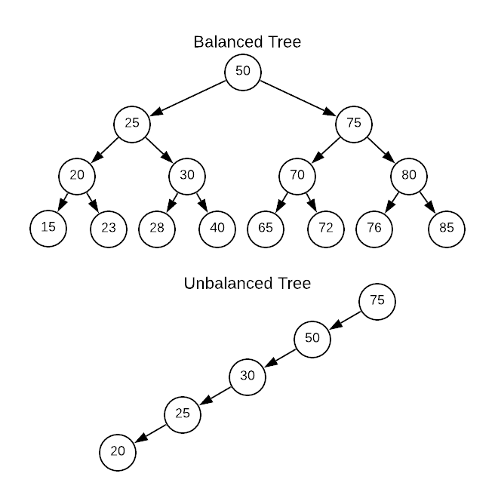
This week’s Tree Concept:
Binary Search Trees

Slide 3
Binary Tree Rules of Shape Validity:
All Parents have AT MOST 2 Children (Left and Right)
The Left Child of a Parent always has a smaller value than the Parent, and the Right Child of a Parent will always have a larger value than the Parent
Thus, all Nodes of a Root’s Right Subtree will have values greater than itself, and all Nodes of a Root’s Left Subtree will have values lesser than itself
Binary Search Trees are used for Searching, Insertion, and Deletion

Slide 4
Balanced vs. Unbalanced Binary Trees
The ideal Shape of any Binary Tree is “balanced”
A Binary Tree is balanced when:
The difference in Height between the Left and Right Subtrees differs by no more than 1
|H_{L} - H_{R}| ≤ 1

Slide 5
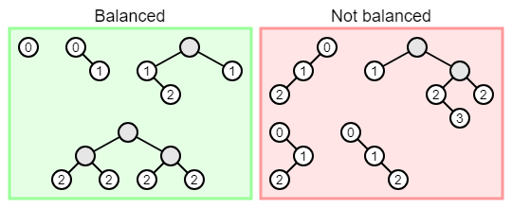

Slide 6
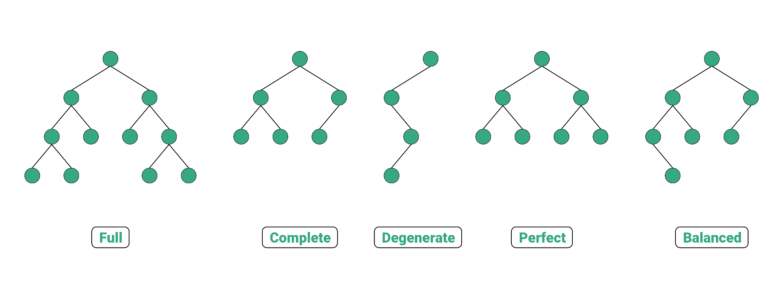
All Interior Nodes have 2 Children AND all Leaves are of the same Level
Height of Left and Right subtrees differ by no more than 1
All Nodes have either 2 or 0 Children
All Levels, except the last one, are completely filled
Each Parent has only 1 Child

Slide 7
How to determine Number of Nodes in a Binary Tree
Size (S) = Maximum possible number of Nodes in a Tree
Since, in a Binary Tree, all Parents have at most 2 Children, we can determine the maximum amount of Nodes at any given Level (L) to be: 2^{L-1} . By extension, we then know 2^{L} will be the maximum amount of Nodes in the whole Tree
However, the first Level of any Tree will always have just 1 Node (Root), Therefore:
*Note: This formula can also derive number of Nodes of any Subtree as well, as long as you know the Level of your Subtree’s Root (R):
S = 2^{(L-R)+1} - 1
*Note: By extension, since we know max Level = max Height, we can say the maximum possible Height of a Binary Tree is:
L or max H = log₂(S+1)
S = 2^{L} - 1

Slide 8
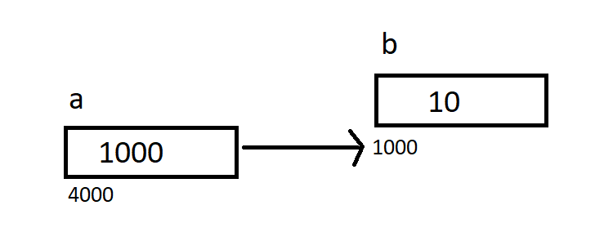
Construction of Binary Search Trees
BSTs are used to store data which can be searched, updated, appended, and deleted
Therefore, the structure of a BST is dynamic; always changing
Because of this dynamic behavior, it is easier to implement BSTs as pointer-structures, rather as arrays (which are allocated a static amount of memory)

Slide 9
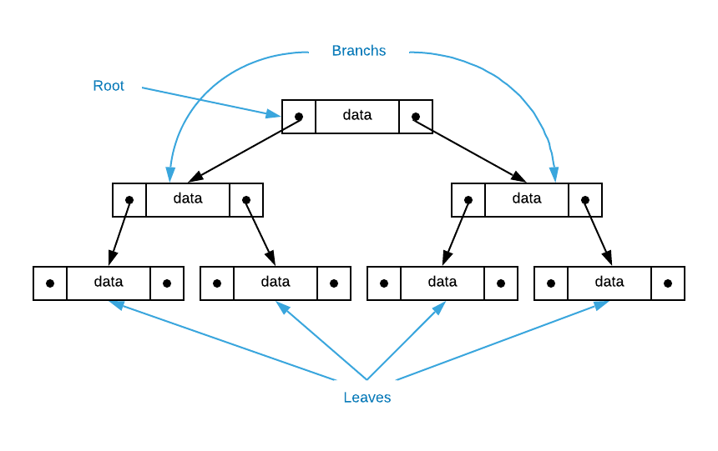

Slide 10
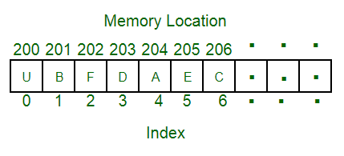
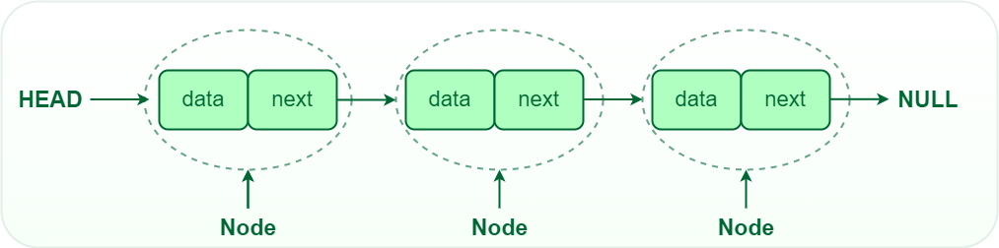
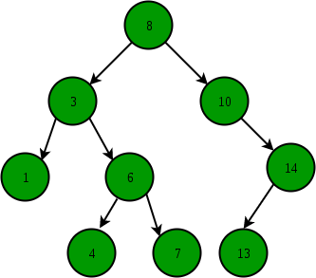
Operation Comparison to other Data Structures (Worst Case)
Array (unsorted)
Linked List
Balanced BST
Searching: O(n)
Insertion: O(n)
Removal: O(n)
Searching: O(n)
Insertion: O(n)
Removal: O(n)
Searching: O(log n)
Insertion: O(log n)
Removal: O(log n)

Slide 11
Searching in Binary Search Trees
Searching in a Binary Search Tree is fundamentally similar to Binary Search in a sorted array:
Begin at Root
Determine if Target is Less Than/Greater Than the Left or Right Child Nodes
Follow the relevant subtree
Repeat 2-3 until Target is found

Slide 12
Note! Searching a BST doesn’t necessarily use Pre/In/Post order traversal, as this .gif showcases. This is because when a the Target is just some value (as opposed to the largest or smallest), we can shimmy our way down the tree in whatever order we need (Note that this .gif goes from the Root to the Right Subtree, which immediately violates all 3 traversal methodologies!)

Slide 13
Insertion in Binary Search Trees
Traversal is the same as in Searching, and so Insertion is similar to Searching:
Begin at Root
Determine if Target is Less Than/Greater Than the Left or Right Child Nodes
Follow the relevant subtree
Repeat 2-3 until you encounter a Leaf
Insert Target to beneath the Leaf’s left or right side

Slide 15
Deletion in Binary Search Trees
Traversal is the same as in Searching and Insertion. Fundamentally, removal in pointer-based BSTs is similar to removing Nodes in a Linked List:
Begin at Root
Determine if Target is Less Than/Greater Than the Left or Right Child Nodes
Follow the relevant subtree
Repeat 2-3 until you encounter the Target Node
If Target is an Interior Node:
Swap the values of Target and Target’s Immediate Successor
Sever the link to Left Child
If Target is a Leaf:
Sever that Leaf’s link to its Parent

Slide 18
Valuable Resources:
Mathematical Proofs of our Formulas
Binary Tree Review
Binary Search Tree Review
Preorder, Inorder, and Postorder Traversal Review
Deleting a Node with 2 Children

Slide 19

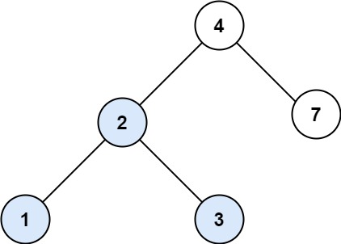
Weekcode Challenge #21:
The BST Search Problem
You are given the root of a binary search tree (BST) and an integer target. Find the node in the BST that the node's value equals target and return the root of that subtree, if such a node exists
Input: root = [4,2,7,1,3], target = 2
Output: [2, 1, 3]

Slide 20
Weekcode Challenge #22:
The BST Insert Problem
You are given the root node of a binary search tree (BST) and a value to insert into the tree. Return the root node of the BST after the insertion. It is guaranteed that the new value does not exist in the original BST. Notice that there may exist multiple valid ways for the insertion, as long as the tree remains a BST after insertion. You can return any of them. (HINT: The solution to this problem is merely a slightly edited version of the easy problem’s solution!)

Slide 21
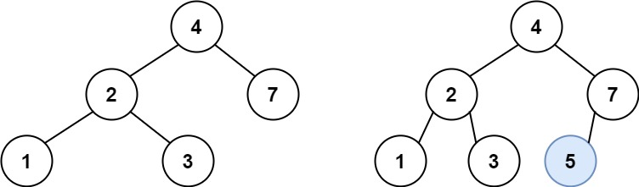
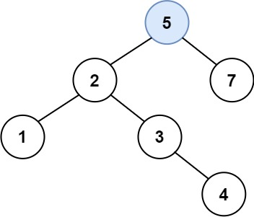
Weekcode Challenge #22:
The BST Insert Problem [EXAMPLE]
Input: root = [4,2,7,1,3], val = 5
Output: [4,2,7,1,3,5]
This type of Tree is also accepted:
Input: root = [4,2,7,1,3], val = 5
Output: [5,2,7,1,3,4]

Slide 22
Weekcode Challenge #23:
The BST Delete Problem
Given a root node reference of a BST and a key, delete the node with the given key in the BST. Return the root node reference (possibly updated) of the BST.
Basically, the deletion can be divided into two stages:
Search for a node to remove.
If the node is found, delete the node.

Slide 23
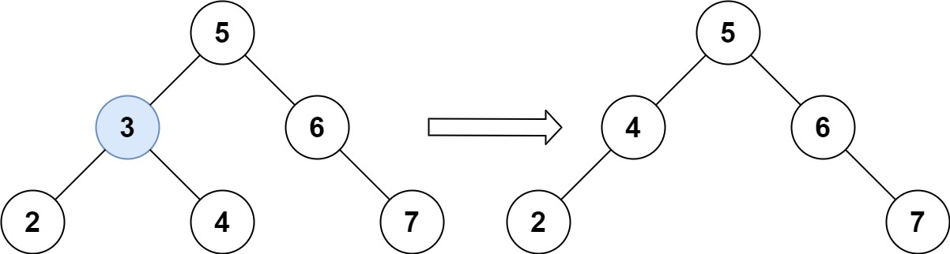
Weekcode Challenge #23:
The BST Delete Problem [EXAMPLE]
Input: root = [5,3,6,2,4,null,7], key = 3
Output: [5,4,6,2,null,null,7]
Explanation: Given key to delete is 3. So we find the node with value 3 and delete it. One valid answer is [5,4,6,2,null,null,7], shown in the above BST.
Please notice that another valid answer is [5,2,6,null,4,null,7] and it's also accepted.

Slide 24
Looking Ahead
Good luck!
Tree Month will persist for all of April
Next week: Min and Max Heaps

